Slide 1
Lectuer-5 Database Design and Applications
Ashish Narang

Slide 2
First Semester
2020-21

Slide 3
Contents
Introduction to SQL
Features of SQL
DDL Statements
DML Statements
Basic Retrieval Queries

Slide 4
Introduction to SQL
SQL was initially called as SEQUEL.
It was designed at IBM labs. //R systems
Later on, acronym SEQUEL was changed to SQL.
Popular commercial query language for relational databases.
Joint effort of ISO and ANSI led to standardization of SQL.
All relational DBMS like Oracle, MySQL, IBMs DB2 support SQL.

Slide 5
Contd..
SQL is a high-level declarative language to specify data retrieval requests for data stored in relational databases.
SQL is relationally complete.
SQL is a standard and many vendors implement it in their own way without deviating from the standard specifications.

Slide 6
Features of SQL
1. DDL (Data Definition Language) Set of commands to support creation, deletion and modification of table structures and views.
2. DML (Data Manipulation Language) Set of commands to pose queries, insert new tuples, and update/delete existing tuples.
3. Embedded SQL: Allows users to call SQL code from host languages like C, C++ & Java.
4. Triggers: Actions executed by the DBMS whenever changes to the database meet specified conditions.
5. Transaction Management: to perform roll-back / commit actions.
6. Indexes: Indexes can be created to speed up the access to data stored in DB.

Slide 7
Create Table Command
It creates a new table and its columns.
Syntax:
CREATE TABLE table-name (
column-name datatype [column constraint]
[, column-name datatype [column constraint] ……….]
[,table constraint] ) ;

Slide 8
Contd..
CREATE TABLE EMP ( Fname VARCHAR(30) NOT NULL, Minit VARCHAR(30),
Lname VARCHAR(30),
Ssn CHAR(9),
Bdate DATE,
Address VARCHAR (100),
Gender CHAR(1),
Salary DECIMAL(10,2), NOT NULL,
Super_ssn CHAR(9) NOT NULL, Dno INTEGER NOT NULL
PRIMARY KEY(Ssn));

Slide 9
Specifying Constraints in SQL
Basic constraints can be specified in SQL as part of table creation.
It includes
-Key constraints
-Referential integrity constraints
-Restrictions on attribute domains and NULLs

Slide 10
Specifying Attribute Constraints and Attribute Defaults
A constraint NOT NULL can be specified if NULL is not permitted for a particular attribute.
It is also possible to define a default value for an attribute by appending the clause DEFAULT <value> to an attribute definition.
CREATE TABLE EMP
(...,
Dno INT NOT NULL DEFAULT 1,

Slide 11
Contd..
Another type of constraint can restrict attribute or domain values using CHECK clause following an attribute.
Example
CREATE TABLE DEPARTMENT
(...,
Dno INT NOT NULL CHECK(Dno>0 AND Dno<21);

Slide 12
Specifying Key and Referential Integrity Constraints
The PRIMARY KEY clause specifies one or more attributes that make up the primary key of a relation. If a primary key has single attribute, the clause can follow attribute directly.
Example
CREATE TABLE DEPARTMENT
(...,
Dno INT Primary Key;

Slide 13
Contd..
Referential integrity constraint is specified using FOREGIN KEY clause.
Example
CREATE TABLE EMPLOYEE
(...,
Dno INT NOT NULL,
FOREIGN KEY(Dno) REFERENCES DEPARTMENT(Dnumber));

Slide 14
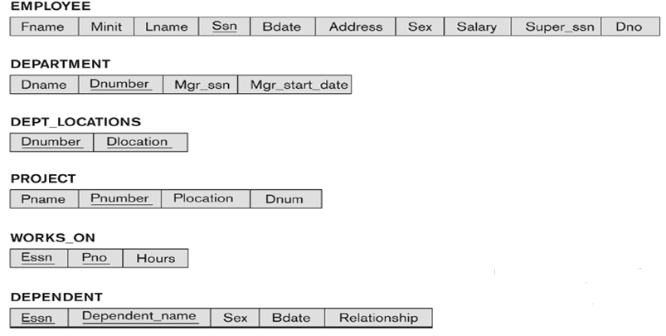
Contd..
Schema of a Company Database

Slide 15
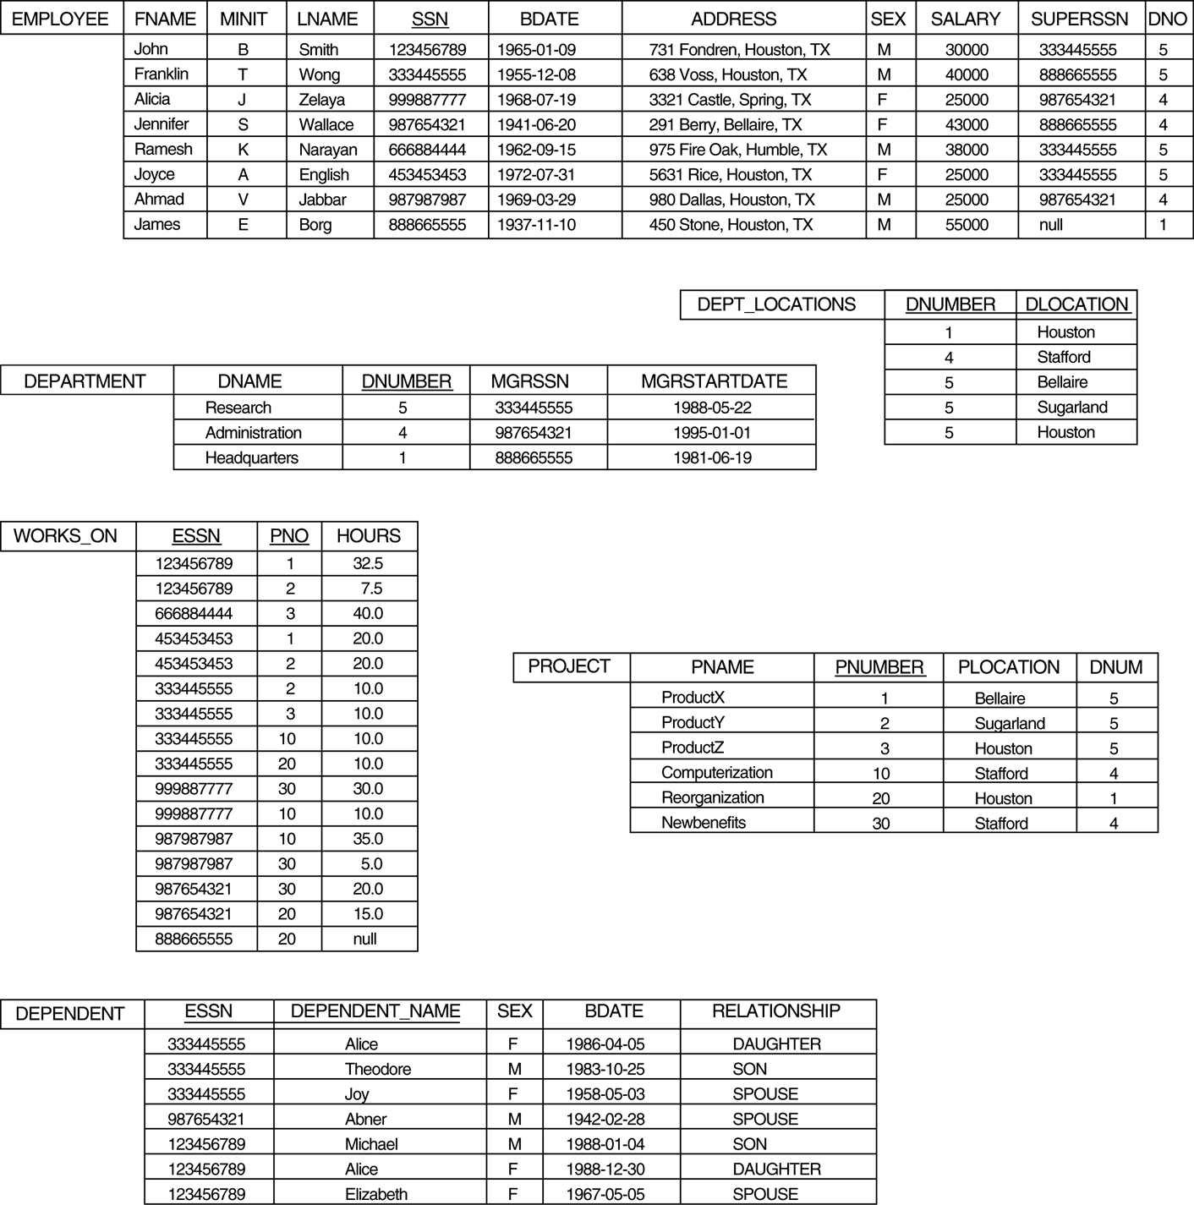
Populated Company Database

Slide 16
Insert Command
Insert is used to add a single tuple to a relation.
We must specify relation name and list of values for the tuple.
The values should be listed in the same order in which the corresponding attributes were specified in the CREATE TABLE command.
Example
INSERT INTO EMPLOYEE
VALUES (‘Richard’,‘K’, ‘Marini’, ‘653298653’, ‘1962-12-30’, ‘98 Oak Forest, Kat,TX’, ‘M’, 37000, ‘653298653’,4);

Slide 17
Contd..
Another way to write insert query.
INSERT INTO EMPLOYEE(Fname, Lname, Dno, Ssn)
Values (‘Richard’, ‘Marini’, 4, ‘653298653’)

Slide 18
Delete Command
Delete is used to remove tuples from a relation.
Depending on the number of tuples selected by the condition in the Where clause, Zero, one or more tuples can be deleted by single delete command
Example 1:
DELETE FROM EMPLOYEE
WHERE Lname=‘Brown’;
Example 2:
DELETE FROM EMPLOYEE
WHERE Dno=5;

Slide 19
Update Command
Update command is used to modify attribute values of one or more selected tuples.
Where clause selects the tuples to be modified.
Example 1:
UPDATE EMPLOYEE
SET Lname=‘Brown’;
WHERE Ssn=‘123456789’;
Example 2:
UPDATE EMPLOYEE
SET Salary=salary*1.1
WHERE Dno=5;

Slide 20
Basic Queries in SQL
Basic form of the SQL SELECT statement is called a mapping or a SELECT-FROM-WHERE block
SELECT <attribute list>
FROM <table list>
WHERE <condition> ;
<attribute list> is a list of attribute names whose values are to be retrieved by the query
<table list> is a list of the relation names required to process the query
<condition> is a conditional (Boolean) expression that identifies the tuples to be retrieved by the query

Slide 21
USE OF *
To retrieve all the attribute values of the selected tuples, a * is used, which stands for all the attributes Examples:
SELECT * FROM EMP

Slide 22
UNSPECIFIED WHERE-Clause
A missing WHERE-clause indicates no condition; hence, all tuples of the relations in the FROM-clause are selected
This is equivalent to the condition WHERE TRUE
Query: Retrieve the Ssn values for all employees.
SELECT Ssn FROM EMP ;

Slide 23
Simple SQL Queries
Example of a simple query on one relation
Query: Retrieve the birthdate and Address of the employee whose name is 'John B. Smith'.
SELECT Bdate, Address FROM EMPLOYEE WHERE Fname='John' AND Minit='B’ AND Lname='Smith’ ;

Slide 24
USE OF DISTINCT
SQL does not treat a relation as a set; duplicate tuples can appear
To eliminate duplicate tuples in a query result, the keyword DISTINCT is used
For example, the result of Q1 may have duplicate Salary values whereas Q1A does not have any duplicate values
Q1: SELECT Salary FROM EMP ;
Q1A: SELECT DISTINCT Salary FROM EMP ;

Slide 25
USE OF LIKE
LIKE operator can be used for string pattern matching.
Example 1: Retrieve all employees whose address is in Houston, Texas.
SELECT Fname,Lname FROM EMP WHERE Address like ‘%Houston,TX%’;
Example 2: Find all employees who were born during 1950
SELECT Fname,Lname FROM EMP WHERE Bdate like ‘_ _ 5 _ _ _ _ _ _ _’;

Slide 26
USE OF BETWEEN
BETWEEN operator can be used to check a value in a interval.
Example: Retrieve all employees in department 5 whose salary is between 30,000 and 40,000.
SELECT * FROM EMP WHERE (salary BETWEEN 30000 AND 40000)
AND Dno=5;

Slide 27
USE OF ORDER BY
SQL allows the user to order the tuples in a result of a query by the values of one or more attributes that appear in query result.
Example: Retrieve all employees in department 5 order by first name
SELECT * FROM EMP WHERE Dno=5
ORDER BY Fname;
DESC clause can be used to reverse the order

